Slide 1

Deconfliction of LoRa Packets Using AlignTrack with Various Windowing Techniques
Kevin Hardin
Applied Communication Systems
Fall Semester 2024

Slide 2

AGENDA
LoRa Overview
AlignTrack Overview
Related Work
What This Project Contributes
How It Works
Results
Why The Results Are This Way
Final Takeaways and Future Work
References

Slide 3
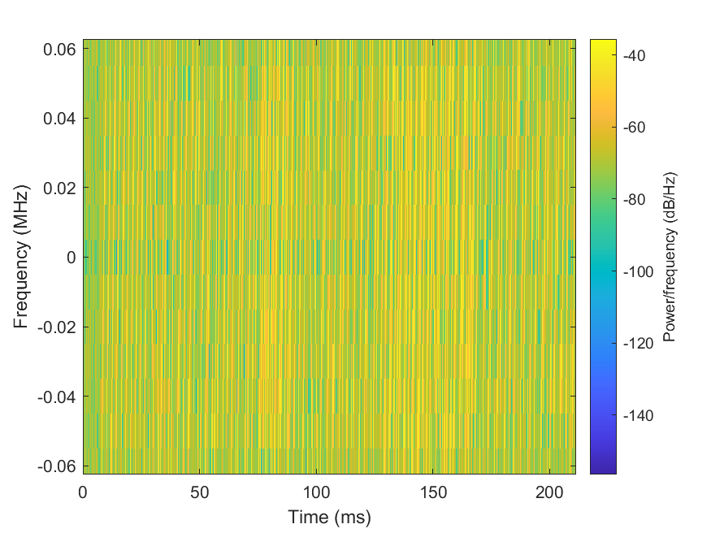
LoRa Overview
Stands for “Long Range”
Modulates a linearly increasing and decreasing “chirp” signal to encode information
Usually in the 915 MHz band
Range can be up to 10 miles, line of sight
LoRa “trades” data rate for range and power and additionally uses forward error correction coding to improve resilience against interference.
LoRa is not immune to collisions, occurring when packets arrive near simultaneously and it can be difficult to distinguish between colliding packets

Slide 4
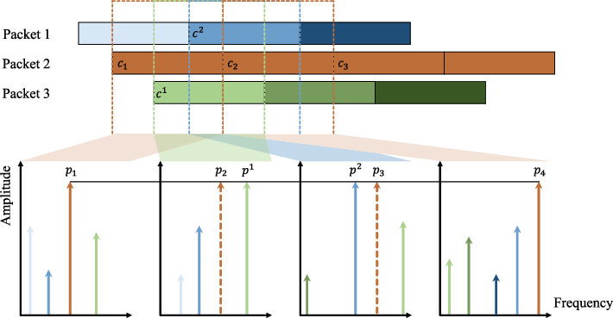
AlignTrack Overview
AlignTrack is a novel approach for decoding LoRa packets in environments with high interference and low signal-to-noise ratios (SNR).
AlignTrack improves upon prior colliding packet decoding methods by leveraging the entire chirp signal rather than partial segments, allowing it to decode multiple overlapping packets more effectively.
The method uses both frequency constraints (to identify peaks for the same chirp across windows) and height constraints (proportionality of peak height to chirp alignment) to decode collided packets accurately.
AlignTrack significantly pushes the decoding SNR limit, making it suitable for more challenging urban and dense LPWAN deployments.
AlignTrack outperforms existing solutions, achieving better packet reception rates in collision-heavy scenarios. Its design relies on precise alignment of chirps across signal windows to mitigate interference and decode with high accuracy.

Slide 5
Related Work
Nscale
Nscale is a technique to address packet collisions in Low-Power Wide Area Networks (LPWANs) like LoRa. It works by leveraging subtle inter-packet time offsets during collisions and converts these into robust frequency-domain features.
CoLoRa
CoLoRa is a system designed to enable multi-packet reception (MPR) in LoRa networks, CoLoRa exploits the inherent chirp properties of LoRa packets and applies a novel signal processing technique to identify and separate collided signals. This involves using unaligned reception windows to process packet segments and isolate frequency peaks corresponding to individual transmitters. Instead of processing one chirp at a time, CoLoRa processes packets "window by window," enabling the separation of overlapping signals without needing synchronized transmissions.
Choir
Choir leverages natural hardware imperfections, such as oscillator frequency offsets in inexpensive IoT devices, to separate overlapping transmissions that traditionally would result in packet loss. These imperfections allow the system to distinguish individual signals even during simultaneous transmissions.

Slide 6
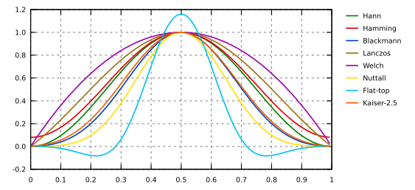
What This Project Contributes
The original AlignTrack paper never assesses the effect of using different windows on the data when aligning it with the start of the packet
This project tests the processing time and the symbol error rate (SER) associated with the usage of the following windows:
Rectangular
Welch
Sine
Hann
Hamming

Slide 7
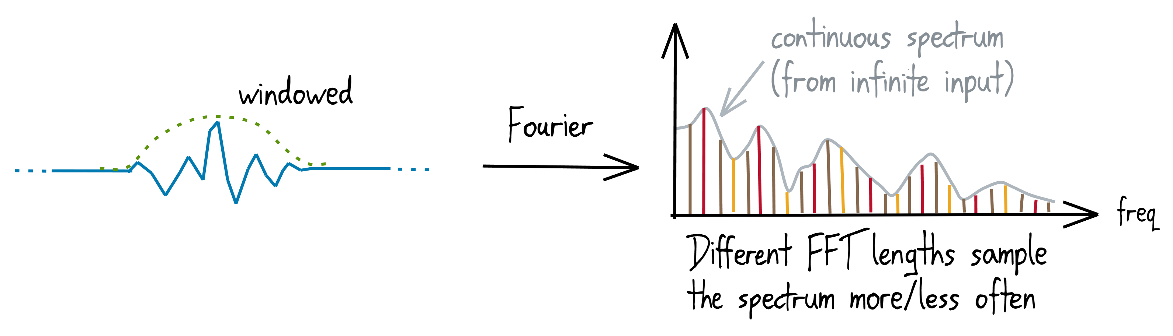
How It Works
First, three packets are generated, added together with random time offsets for their starts (0% < offset < 50%), and finally random noise is applied to simulate the transmission of colliding LoRa packets
The start of the first packet is determined, the window being tested is multiplied with signal (not convolved with it), then the AlignTrack algorithm determines the potential start positions of subsequent packets (after removing the influence of sidelobes in the FFT)
Packets are decoded and compared with their respective inputs to determine symbol error rate (SER)
100 trials containing all five windows are conducted, then elapsed times and SER are plotted

Slide 8
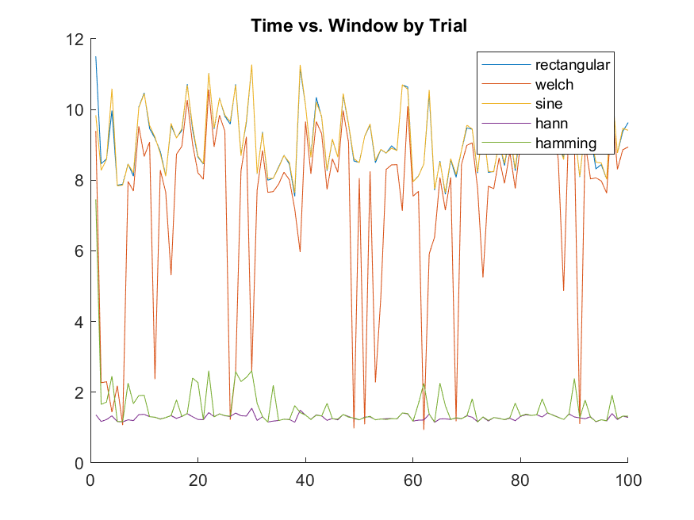
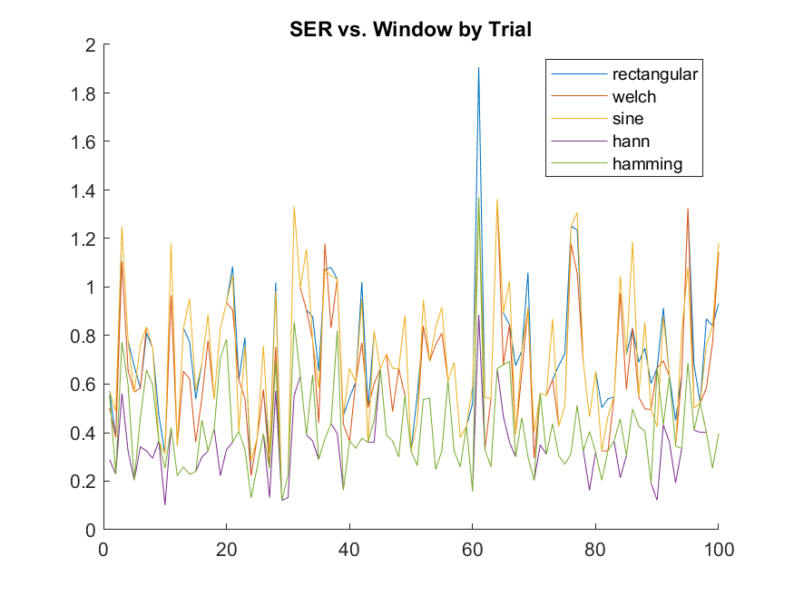
Results

Slide 9
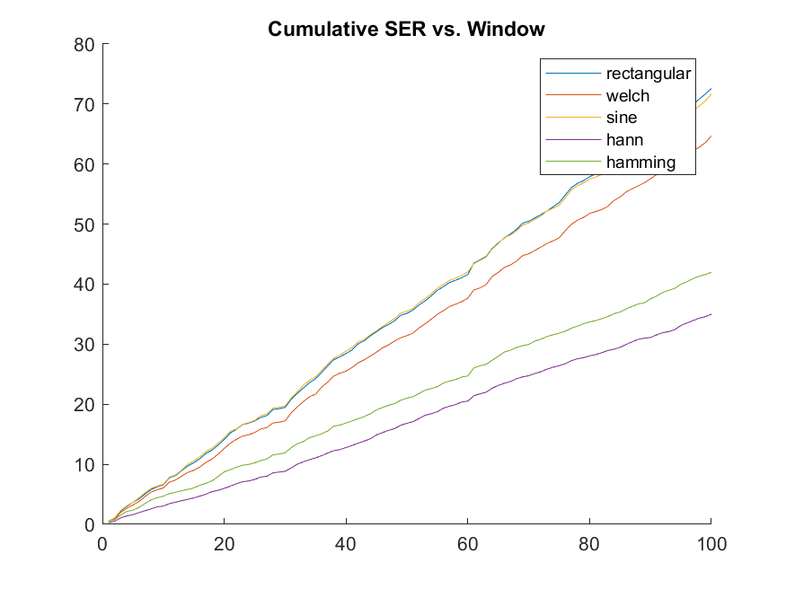
Results (cont.)

Slide 10
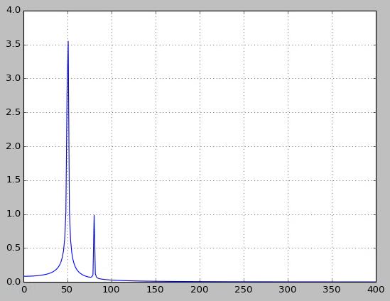
Why The Results Are This Way
Clearly, some windowing is better than none (rectangular)
This could be because the FFT benefits from the data being at zero amplitude at the start and end of the packets
Additionally, crucial packet information is likely emphasized in the window while information outside the window is rid of its influence
The time aspect of the windows could in part have to do with how they are generated by Matlab. However, if this were the whole truth, the rectangular window would perform much better than it does
The FFT peaks corresponding to the packet signals may be better distinguished by the AlignTrack algorith when windows are used

Slide 11
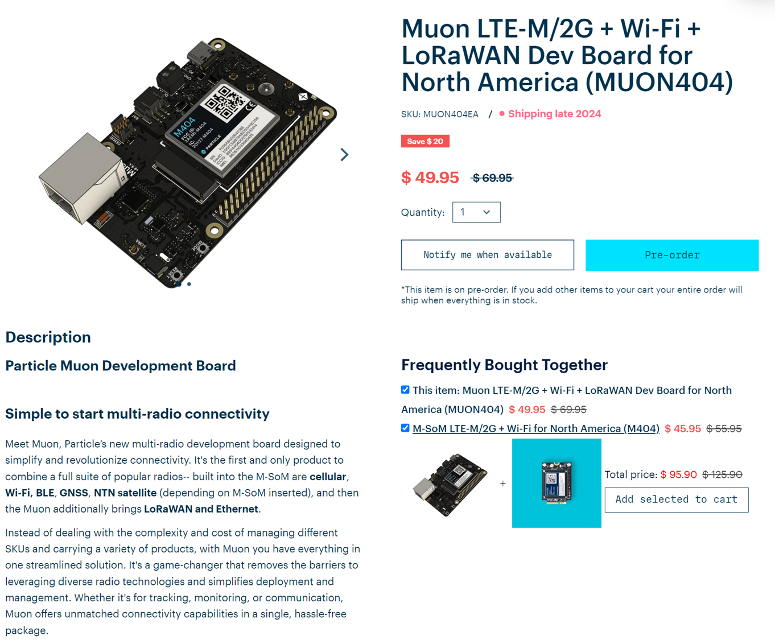
Final Takeaways and Future Work
The Hann window universally yields faster and more accurate decoding of collided packets
The rectangular window used by the original AlignTrack paper is among the worst windows tested
Future work could consist of:
Testing more windows
Translating code to C
Implementing in transmissions/collisions in hardware
Adding mesh capability for nodes
Testing in real-world environment
Improving code efficiency where possible to improve computing time

Slide 12
References
Chen, Qian & Wang, Jiliang. (2023). AlignTrack: Push the SNR Limit of LoRa Collision Decoding. IEEE/ACM Transactions on Networking. PP. 1-16. 10.1109/TNET.2023.3235041.
Shuai Tong, Jiliang Wang, and Yunhao Liu. 2020. Combating packet collisions using non-stationary signal scaling in LPWANs. In Proceedings of the 18th International Conference on Mobile Systems, Applications, and Services (MobiSys '20). Association for Computing Machinery, New York, NY, USA, 234–246. https://doi.org/10.1145/3386901.3388913
S. Tong, Z. Xu and J. Wang, "CoLoRa: Enabling Multi-Packet Reception in LoRa," IEEE INFOCOM 2020 - IEEE Conference on Computer Communications, Toronto, ON, Canada, 2020, pp. 2303-2311, doi: 10.1109/INFOCOM41043.2020.9155509. keywords: {Chirp;Interference;Decoding;Time-frequency analysis;Frequency modulation;Receivers;Internet of Things},
Rashad Eletreby, Diana Zhang, Swarun Kumar, and Osman Yağan. 2017. Empowering Low-Power Wide Area Networks in Urban Settings. In Proceedings of the Conference of the ACM Special Interest Group on Data Communication (SIGCOMM '17). Association for Computing Machinery, New York, NY, USA, 309–321. https://doi.org/10.1145/3098822.3098845
Chen, Qian, and Jiliang Wang. “Aligntrack: Push the limit of Lora Collision Decoding.” 2021 IEEE 29th International Conference on Network Protocols (ICNP), 1 Nov. 2021, https://doi.org/10.1109/icnp52444.2021.9651985.
Fourier Transform, gwyddion.net/documentation/user-guide-en/fourier-transform.html. Accessed 1 Dec. 2024. Luff, Geraint.
“Extra-Wide Window Functions.” Signalsmith Audio, signalsmith-audio.co.uk/writing/2021/extra-wide-windows/. Accessed 1 Dec. 2024.

